Slide 1
6 – Clean Code – TDD part 1
Based on the CleanCoders videos by Uncle Bob Martin
Rupert Waldron

Slide 2
Introduction
We saw in the original presentation how code rots, becomes fragile and rigid. Changes take for ever and often require changes to many modules and break unexpected parts of the cause, or cause unexpected behaviors.
Solution… clean the code
We don’t clean it because we are afraid we would break it… and if you break it, it will become yours!!
We need to eliminate the FEAR

Slide 3
Eliminating the fear
With a fantastic test suite… created using Test Driven Development

Slide 4
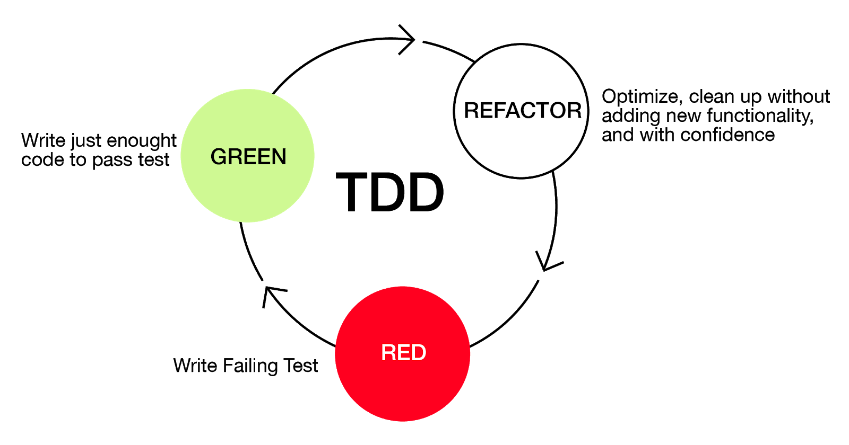

The Three Laws of TDD
Not compiling is also failing
Start here

Slide 5
Some of the benefits
Writing tests firsts makes production code testable – this means to code will naturally be de-coupled
You are only a few minutes away from fully working code as each cycle should only take a few minutes
You have ready to go documentation because all the use of the code is demonstrated by the test suite.

Slide 6



















What would happen if you had a suite of tests that gave you a very high degree of confidence that the tests were working?

Slide 7
Over to the petstore api… tdd style

